Slide 1
PRESS KIT

Slide 2
BIO
Alexis (Lexie) is a writer with a day job for the last twenty years servicing her community and its everyday heroes.
Born in Tucson her heart still remains there, but she lives, works, and writes in Indy. Her desire to see the whole country is almost complete (seven states left) and as much of the world as she can (7 countries down, 188 to go!
She collects fountain pens, perfume bottles, rescue animals, and dirty curse words in as many languages as she can. Her list of hobbies is longer than her arms and legs combined (even though she is on the petite side so that isn’t hard) including knitting, crocheting, painting, graphic design, and learning to play the piano.
In addition to 'writer', her life has many roles including wife, dog mom, fun aunt, and ghost hunter.
Lexie’s goal is to cram as much living into one life as possible and write about it along the way.

Slide 3
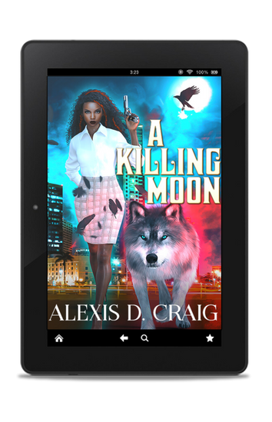
Alexis D Craig
Alexis D Craig
Romance with a side of
Paranormal
Erotica
Contemporary
Comedy
Suspense
Alexis D Craig

Slide 4
REVIEW OF A KILLING MOON—The Quick and Dirty Bibliophile
Overall: 4.5/5 ⭐⭐⭐⭐💫 Steam:🔥🔥 Feels: 😏😲😎😱 ~REVIEW🖋~ The Quick and Dirty: Spies, palace intrigue, attempted murder, scandals, betrayal and 🔥🔥🔥 Cora is a raven shifter and freelance former spy who has been hired to protect Finnegan O’Casey, second in line to the throne of House Lupine; a kingdom wherein the king is ailing and the heir to the throne is Finn’s cruel older brother, Brendan. Finn doesn’t realize Cora is actually a blast from his past, but even when that secret is brought to light, neither can deny that the chemistry between them is 🔥🔥🔥. As they spend more time together, Cora’s motives for protecting Finn change from purely professional to something more. And as they work together to expose Brendan for the murderous tyrant he is, the plan they employ to sabotage Brendan’s plans backfires on them, but in the most spectacular way that will change both of their lives (and the future of the series)! Such a fun book! This first book is setting up the series to be action-packed, suspenseful and sexy. I can’t wait to see what happens next!

Slide 5
A Killing Moon
A Killing Moon
Review of A Killing Moon
By Serpentine Creative

Slide 6
BB
MEDIA
Twitter
Facebook
Goodreads
Amazon
Bookbub
Spotify
Pinterest
Instagram
ARC Team

